Slide 1
Presented By
Wahia Tasnim
IT-16029
MD.Abu Saleh Shipon
IT-15064
Group no:26

Slide 2
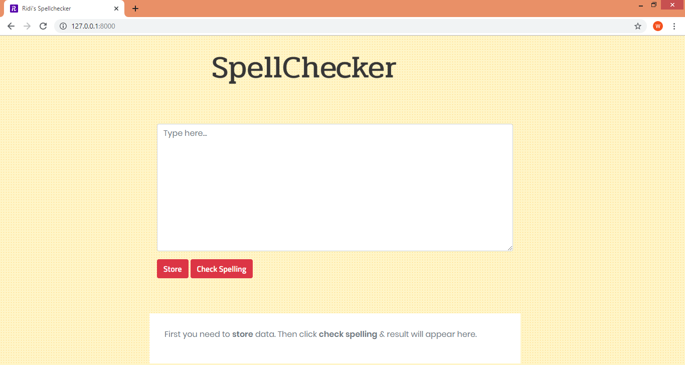
Here, I repersent my spellchecker project. This spellchecker finds if there is any misspell occur in the given word or sentence and also shows the similar word for the mis-spelled word.

Slide 3
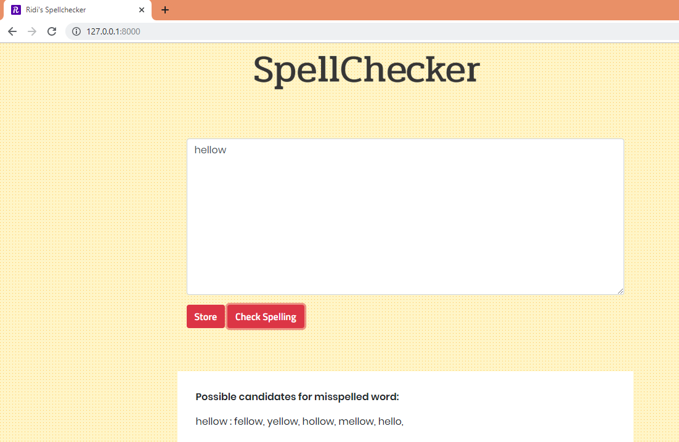
An example of mis-spelled word output is showed below:-

Slide 4
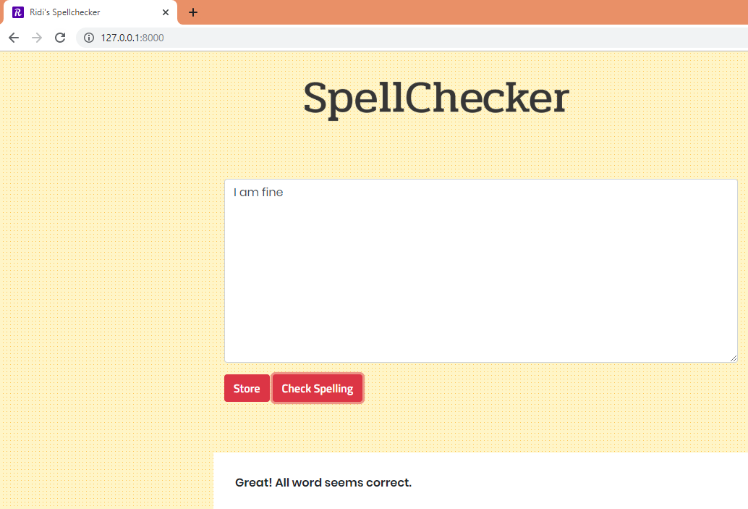
An example of a correct sentence output is showed below:-

